Slide 1

UECS3313 / MPU33213
Computer Ethics and Professional Responsibility
Oct 2015
UECS3313/MPU33213-SE-Oct2015

Slide 2

Hacking
Identity Theft and Credit Card Fraud
Security research
Hacktivism and cyberwar
Ethical responsibility for security
Whose Laws Rule the Web (Global aspects of computer crime laws)
UECS3313/MPU33213-SE-Oct2015

Slide 3
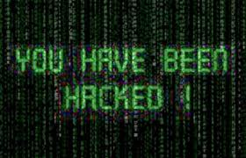


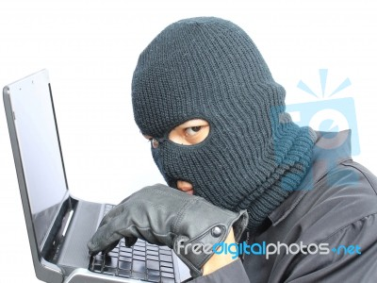
UECS3313/MPU33213-SE-Oct2015

Slide 4

Intentional, unauthorized access to computer systems
The term has changed over time
Phase 1: The joy of programming
  Early 1960s to 1970s
  It was a positive term
  A "hacker" was a creative programmer who wrote elegant or clever code
  A "hack" was an especially clever piece of code
UECS3313/MPU33213-SE-Oct2015

Slide 5
Phase 2: 1970s to mid 1990s
  Hacking took on negative connotations
  Breaking into computers for which the hacker does not have authorized access
  Still primarily individuals
  Includes the spreading of computer worms and viruses and ‘phone phreaking’
  Companies began using hackers to analyze and improve security
UECS3313/MPU33213-SE-Oct2015

Slide 6
Phase 3: The growth of the Web and mobile devices
  Beginning in mid 1990s
  The growth of the Web changed hacking; viruses and worms could be spread rapidly
  Political hacking (Hacktivism) surfaced
  Denial-of-service (DoS) attacks used to shut down Web sites
  Large scale theft of personal and financial information
UECS3313/MPU33213-SE-Oct2015

Slide 7

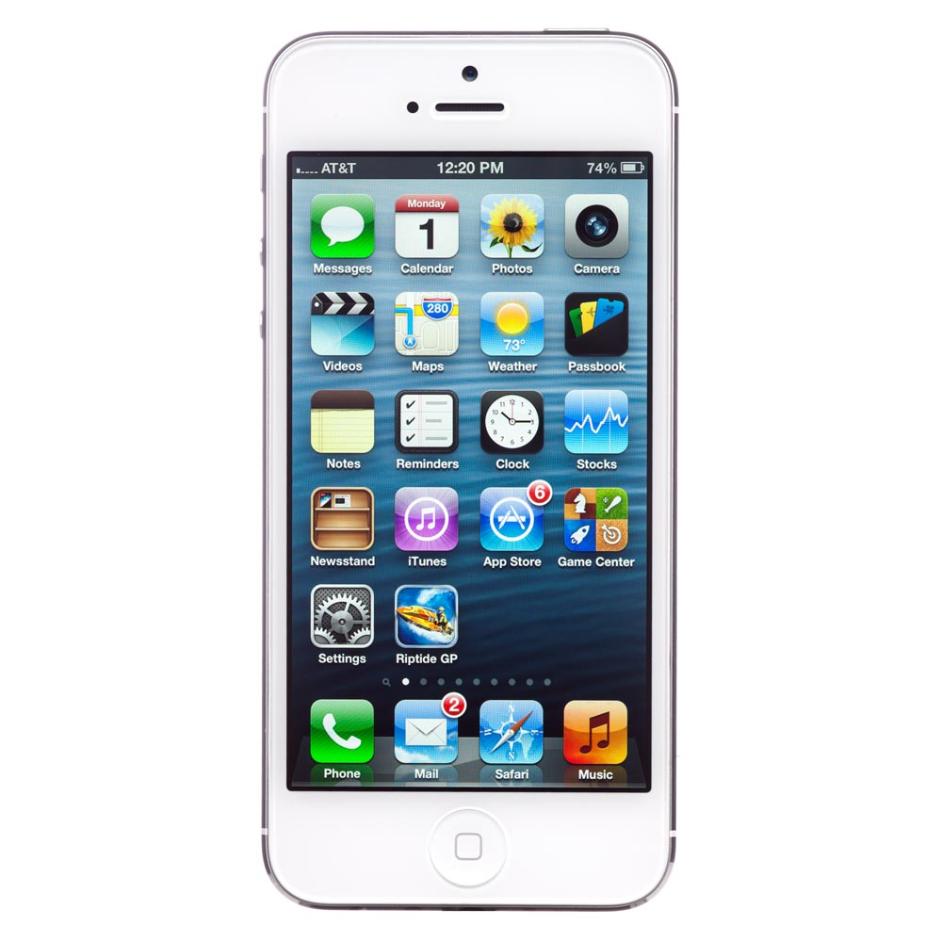
UECS3313/MPU33213-SE-Oct2015

Slide 8

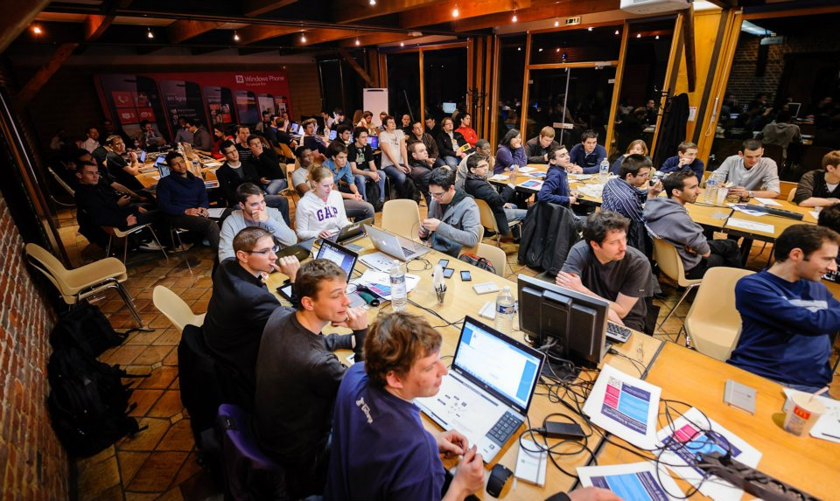
UECS3313/MPU33213-SE-Oct2015

Slide 9
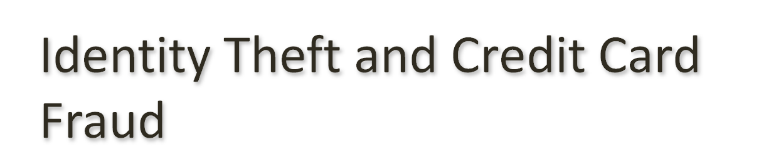
Stealing Identities
Identity Theft – various crimes in which criminals use the identity of an unknowing, innocent person
  Use credit/debit card numbers, personal information, and social security numbers
  18-29 year-olds are the most common victims because they use the Web most and are unaware of risks
  E-commerce has made it easier to steal and use card numbers without having the physical card
UECS3313/MPU33213-SE-Oct2015
Notes:
The Federal Trade Commission receives hundreds of thousands of complaints of identity theft each year. Losses from identity theft amount to billions of dollars per year in the U.S., with several million victims. A single incident can affect thousands of people.
Credit card companies and other businesses bear the direct cost of most credit card fraud, but the losses lead to higher charges to consumers. In addition, individual victims might lose a good credit rating, be prevented from borrowing money or cashing checks, be unable to get a job, or be unable to rent an apartment.

Slide 10
Stealing Identities
Techniques used to steal personal and financial information
  Requests for personal and financial information disguised as legitimate business communication
    Phishing – e-mail
    Smishing – text messaging
    Vishing – voice phishing
Pharming – false Web sites that fish for personal and financial information by planting false URLs in Domain Name Servers (DNSs)
Online resumés and job hunting sites may reveal SSNs, work history, birth dates and other information that can be used in identity theft
UECS3313/MPU33213-SE-Oct2015
Notes:
Phising – emails sent out to con someone in giving away their sensitive financial information

Slide 11

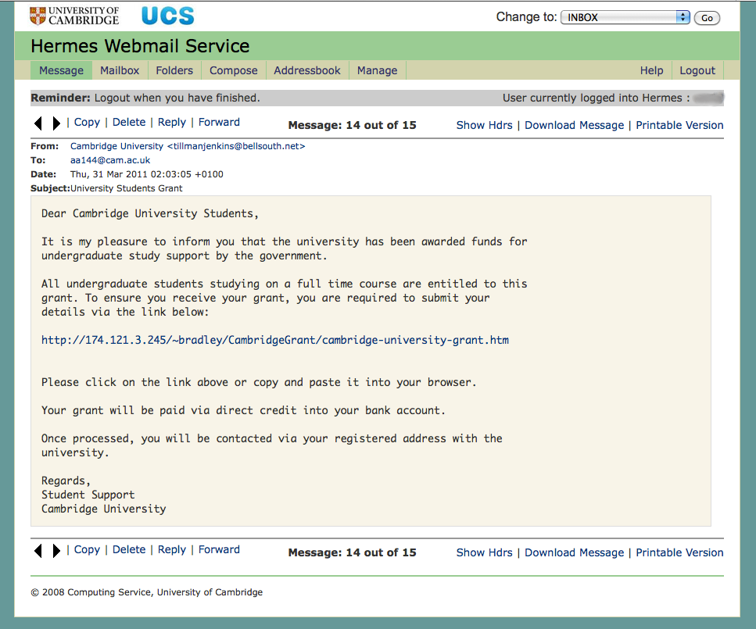
Phishing - emails sent to con someone in giving away their sensitive financial information
UECS3313/MPU33213-SE-Oct2015

Slide 12
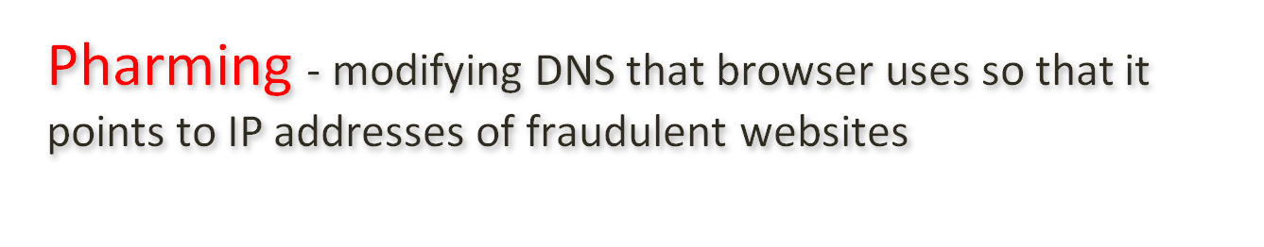
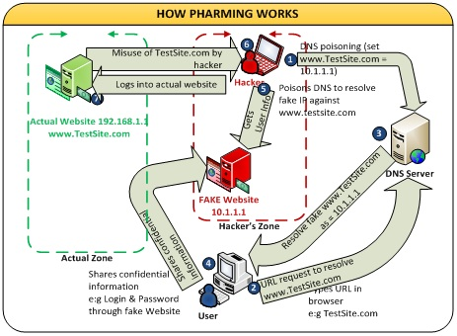
UECS3313-SE-Oct2013
UECS3313/MPU33213-SE-Oct2015

Slide 13
Responses to Identity Theft
Authentication of email and Web sites
Use of encryption to securely store data, so it is useless if stolen
Authenticating customers to prevent use of stolen numbers, may trade convenience for security
In the event information is stolen, a fraud alert can flag your credit report; some businesses will cover the cost of a credit report if your information has been stolen
UECS3313/MPU33213-SE-Oct2015

Slide 14
Responses to Identity Theft
Authenticating customers and preventing use of stolen numbers
  Activation for new credit cards
  Retailers do not print the full card number and expiration date on receipts
  Software detects unusual spending activities and will prompt retailers to ask for identifying information
  Services, like PayPal, act as third party allowing a customer to make a purchase without revealing their credit card information to a stranger
UECS3313/MPU33213-SE-Oct2015

Slide 15
Biometrics
Biological characteristics unique to an individual
No external item (card, keys, etc.) to be stolen
Used in areas where security needs to be high, such as identifying airport personnel
Biometrics can be fooled, but more difficult to do so, especially as more sophisticated systems are developed
UECS3313/MPU33213-SE-Oct2015

Slide 16

Viruses and worms
  Disabled networks and Internet, also targeting social networking environments
  Caused hundreds of millions or billions of dollars in damage
Denial-of-service attacks
  shut down major websites
  orchestrated using zombie machines
UECS3313/MPU33213-SE-Oct2015

Slide 17

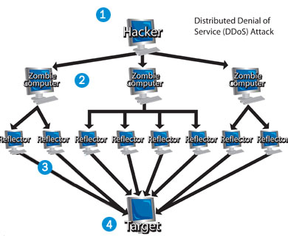
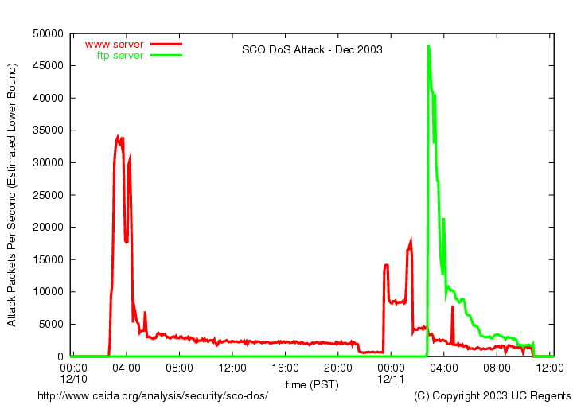
UECS3313/MPU33213-SE-Oct2015

Slide 18

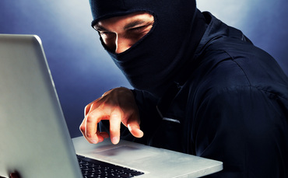
UECS3313/MPU33213-SE-Oct2015

Slide 19

Hacking into sensitive databases
  stealing credit card numbers from retailers, banks, etc
  Email spam and various online advertising fraud designed to steal credit card numbers
UECS3313/MPU33213-SE-Oct2015

Slide 20

Cannot distinguish nonmalicious / malicious
  Need to shut down external Internet connection
  Must expend time and effort to track down the intruder
For system with a lot of sensitive data
  must check that data was not tampered with or copied.
even with good intentions
  can make a mistake and do damage accidentally.
All hacking is a form of trespass without permission
  violation of basic property rights.
UECS3313/MPU33213-SE-Oct2015

Slide 21
Is “harmless hacking” harmless?
Responding to non-malicious or prank hacking uses resources.
Hackers could accidentally do significant damage.
Almost all hacking is a form of trespass.
UECS3313/MPU33213-SE-Oct2015

Slide 22
Hackers as Security Researchers
“White hat hackers” use their skills to demonstrate system vulnerabilities and improve security
UECS3313/MPU33213-SE-Oct2015
Notes:
Ethical dilemmas:
Is it ethical to break into a system without permission, even with good intentions?
How can people responsibly inform potential victims of security vulnerabilities without informing malicious hackers who would exploit them?
Many security researcher hackers are scornful of big software companies because of the large number of security flaws in their products and because they are slow to plug leaks even when they know of them.

Slide 23

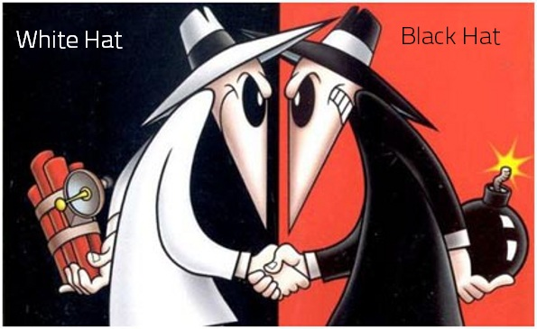
UECS3313/MPU33213-SE-Oct2015

Slide 24

Probe computer systems to find security flaws
Ethical aspect of harmless hacking
  Hacking system without permission
  Legal way – penetration testing
Ethical aspect of revealing vulnerabilities
  Responsible approach is to inform the company responsible and allow time patches
  Avoid problems with malicious hackers exploiting weaknesses.
  However many big software companies are slow to plug leaks
  Publicizing security problems spurs companies to take action – “gray” hats
UECS3313/MPU33213-SE-Oct2015

Slide 25
Hacking as Foreign Policy
Hacking by governments has increased
Pentagon has announced it would consider and treat some cyber attacks as acts of war, and the U.S. might respond with military force.
How can we make critical systems safer from attacks?
UECS3313/MPU33213-SE-Oct2015
Notes:
Many cyber attacks come from China. The nature and sophistication of the attacks, as well as the type of targets, lead security researchers to believe that they are the work of government agencies, not civilian hackers.
A 2011 attack on the Gmail accounts of White House staffers, China policy experts, military officials, human rights activists, and others originated in a Chinese city where a major Chinese national security division is located. The attack used email carefully written in government jargon about State Department reports to fool the recipients into thinking the email was authentic. High-level government officials (and other people targeted) disclosed their passwords, allowing hackers to read their email for months.

Slide 26
Stuxnet
An extremely sophisticated worm
Targets a particular type of control system
Beginning in 2008, damaged equipment in a uranium enrichment plant in Iran
UECS3313/MPU33213-SE-Oct2015
Notes:
The focus on Iran’s nuclear program and the sophistication of Stuxnet led to speculation that the Israeli and/or U.S. government created it. In 2012, journalist David Sanger published extensive research indicating that the two governments did indeed produce Stuxnet.
Is cyber sabotage against Iran justified? (Is it better than a military attack by Israel on Iran’s nuclear facilities?)
Will China, Russia, or other governments cite Stuxnet as an excuse for their own cyber intrusions into the U.S. and other countries?

Slide 27
Security
Hacking is a problem, but so is poor security.
Variety of factors contribute to security weaknesses:
  History of the Internet and the Web
  Inherent complexity of computer systems
  Speed at which new applications develop
  Economic and business factors
  Human nature
UECS3313/MPU33213-SE-Oct2015

Slide 28
Security
Internet started with open access as a means of sharing information for research.
Attitudes about security were slow to catch up with the risks.
Firewalls are used to monitor and filter out communication from untrusted sites or that fit a profile of suspicious activity.
Security is often playing catch-up to hackers as new vulnerabilities are discovered and exploited.
UECS3313/MPU33213-SE-Oct2015

Slide 29
Responsibility for Security
Developers have a responsibility to develop with security as a goal.
Businesses have a responsibility to use security tools and monitor their systems to prevent attacks from succeeding.
Home users have a responsibility to ask questions and educate themselves on the tools to maintain security (personal firewalls, anti-virus and anti-spyware).
UECS3313/MPU33213-SE-Oct2015

Slide 30
Hacktivism, or Political Hacking
Use of hacking to promote a political cause
Disagreement about whether it is a form of civil disobedience and how (whether) it should be punished
Some use the appearance of hacktivism to hide other criminal activities
How do you determine whether something is hacktivism or simple vandalism?
UECS3313/MPU33213-SE-Oct2015
Notes:
A factor to consider when evaluating hactivism is the political system under which the hacktivists live. From both an ethical and social perspective, in free countries where almost anyone can tweet or post their words and video on the Web for free, it is hard to justify hacking someone else’s site to promote a political cause. On the other hand, countries with oppressive governments control the means of communications and prohibit open political discussion, have secret police who kill dissenters, ban some religions, and jail people who express opposition views. In such countries, where openly communicating one’s views is impossible or dangerous, there might be good arguments to justify political hacking to get one’s message out to the public and, in some cases, to sabotage government activities.

Slide 31

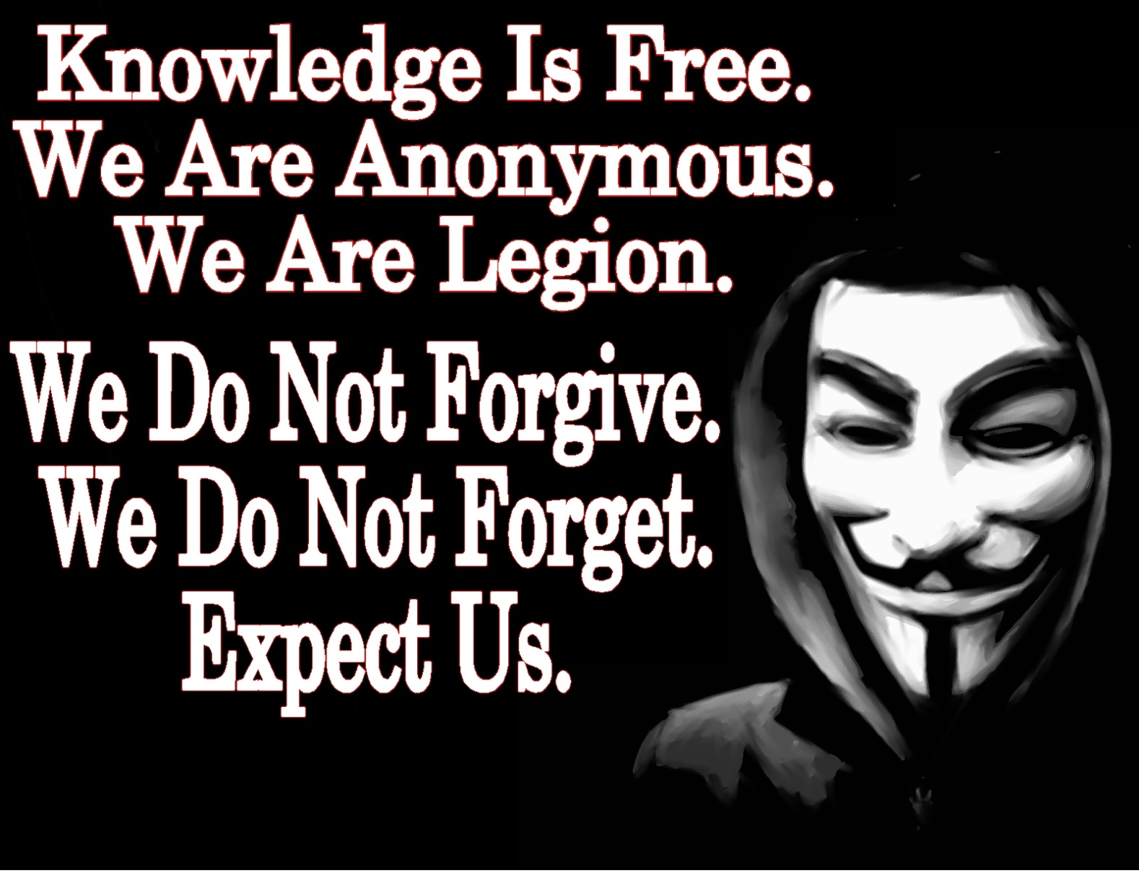
UECS3313/MPU33213-SE-Oct2015

Slide 32

Hacking to promote a political cause
  Consider it on a scale from peaceful resistance to destructive actions
Exercising freedom of speech
  Defacing a website compels others to listen.
  need to respect basic rights of others and not impose our views
Effect of political system
  In free countries, other alternative possible such as social media
  Justifiable where govts are oppresive
UECS3313/MPU33213-SE-Oct2015

Slide 33

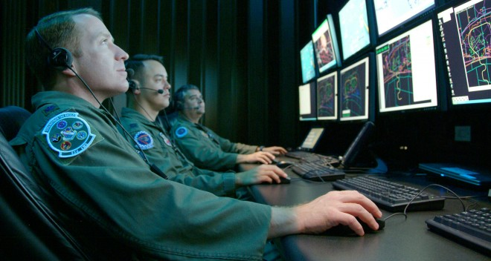
UECS3313/MPU33213-SE-Oct2015

Slide 34

Hacking by governments
  source of attacks are hard to determine
  sophistication of the attacks, and type of targets
  for economic and military espionage
  to disable IT infrastructure in the countries of enemies or future enemies
Ethical concerns
  If respond with military force, must correctly determine true source of attacks
UECS3313/MPU33213-SE-Oct2015

Slide 35

Techniques for developing secure software systems exist
  software companies should be aware and use them to spare users from security threats
For computer system with valuable or sensitive data
  System administrators must take security precautions to protect
  need to stay up to date about new risks and new security measures
UECS3313/MPU33213-SE-Oct2015

Slide 36

Ordinary people lack understanding
  Sellers of widely used consumer products should build in a level of safety for the general public
Most sensitive security vulnerabilities
  major infrastructure and defense systems
  companies and government agencies must be responsible
UECS3313/MPU33213-SE-Oct2015

Slide 37
The Law: Catching and Punishing Hackers
1984 Congress passed the Computer Fraud and Abuse Act (CFAA)
  Covers government computers, financial and medical systems, and activities that involve computers in more than one state, including computers connected to the Internet
  Under CFAA, it is illegal to access a computer without authorization
  The USA PATRIOT Act expanded the definition of loss to include the cost of responding to an attack, assessing damage and restoring systems
UECS3313/MPU33213-SE-Oct2015

Slide 38
The Law: Catching and Punishing Hackers
Catching hackers
  Law enforcement agents read hacker newsletters and participate in chat rooms undercover
  They can often track a handle by looking through newsgroup or other archives
  Security professionals set up ‘honey pots’ which are Web sites that attract hackers, to record and study
  Computer forensics specialists can retrieve evidence from computers, even if the user has deleted files and erased the disks
  Investigators trace viruses and hacking attacks by using ISP records and router logs
UECS3313/MPU33213-SE-Oct2015
Notes:
Most people are unaware that word processors and other programs include a lot of “invisible information” in files – in some cases, unique identifying numbers and the author’s name. Security experts use such information to trace viruses. The hidden identifying information in files worries privacy advocates – another reminder of the tension between privacy and crime fighting.
When law enforcement methods receive publicity, hackers learn what mistakes to avoid. Law enforcement and security personnel update their skills and tools as hackers change theirs.

Slide 39
The Law: Catching and Punishing Hackers
Penalties for young hackers
  Many young hackers have matured and gone on to productive and responsible careers
  Temptation to over or under punish
  Sentencing depends on intent and damage done
  Most young hackers receive probation, community service, and/or fines
  Not until 2000 did a young hacker receive time in juvenile detention
UECS3313/MPU33213-SE-Oct2015
Notes:
In 2000, a 16-year-old was sentenced to six months in a juvenile detention facility. He was the first juvenile incarcerated for hacking. He had broken into NASA and Defense Department computers and was a member of a hacker group that vandalized government Web sites. As more young people caused more disruption, the severity of penalties increased.

Slide 40

Many exploits have no financial gain
  Young hackers are immature and do not fully understand the consequences of their actions.
  find a right level to penalize and also allow them to mature and go on to productive careers
Flexibility in penalizing
  focus on using skills in a productive way or paying fines
Giving jobs to hackers
  May encourage young people to hack as a form of resumse
  Job could give responsibility and respect to turn the hacker’s energy toward productive use
UECS3313/MPU33213-SE-Oct2015

Slide 41

Posting of viruses and hacking tools
  Irresponsible if done to encourage use
Proposal to make it a crime
  will not work to deter serious hackers and criminals
  deny the ability for researchers to learn and update themselves.
  Could violate freedom of speech - software as a form of speech
UECS3313/MPU33213-SE-Oct2015

Slide 42
The Law: Catching and Punishing Hackers
Expansion of the Computer Fraud and Abuse Act
  The CFAA predates social networks, smartphones, and sophisticated invisible information gathering.
  Some prosecutors use the CFAA to bring charges against people or businesses that do unauthorized data collection.
  Is violating terms of agreement a form of hacking?
UECS3313/MPU33213-SE-Oct2015
Notes:
Is violating the terms of use of a Web site a crime under CFAA’s provision about exceeding one’s authorized access for the purpose of committing fraud and obtaining something of value? The first major case involved a woman who pretended to be a 16-year-old boy on MySpace, began an online flirting relationship with a 13-year-old girl in her neighborhood (a former friend of the woman’s daughter), then broke off the relationship and sent cruel messages. The girl killed herself. The woman’s behavior was nasty and unethical. People wanted to see her punished, but it was not clear that she had broken any law. Prosecutors charged her with illegal hacking under the CFAA. A jury convicted the woman, but a judge reversed the conviction. Normally, a breach of contract is not a criminal offense.

Slide 43

When Digital Actions Cross Borders
Laws vary from country to country.
Corporations that do business in multiple countries must comply with the laws of all the countries involved.
Someone whose actions are legal in their own country may face prosecution in another country where their actions are illegal.
UECS3313/MPU33213-SE-Oct2015

Slide 44

Key areas of difference
  Content control/censorship laws
  Intellectual property
  Hacking/viruses
  Libel
  Privacy
  Commerce and spam
Creates dilemmas
  subjective interpretation on controversial issues
UECS3313/MPU33213-SE-Oct2015

Slide 45
Yahoo and French censorship
Display and sale of Nazi memorabilia illegal in France and Germany
Yahoo was sued in French court because French citizens could view Nazi memorabilia offered on Yahoo’s U.S.-based auction sites
Legal issue is whether the French law should apply to Yahoo auction sites on Yahoo’s computers located outside of France.
UECS3313/MPU33213-SE-Oct2015
Notes:
Display and sale of Nazi memorabilia are illegal in France and Germany, with some exceptions for historical purposes. Two antiracism organizations sued Yahoo in a French court in 1999 because French people could view Nazi memorabilia offered for sale on Yahoo’s U.S.-based auction sites. The French government also brought criminal charges against Yahoo and former CEO Tim Koogle for justifying a crime against humanity. (Yahoo’s French sites, based in France, complied with the French law.)
Yahoo argued that it was not technically feasible to block access from France. In addition, French people could access Yahoo’s sites from outside France or using anonymizing services. Geolocation software was fairly new, but a French court ordered Yahoo to make a serious effort to use such tools to block access by French people to material France deemed illegal.
Koogle did not go to France to attend his trial. Yahoo and Koogle were acquitted because the court decided that permitting the auctions was not “justifying” the Nazi crimes. The decision did not resolve the issue of whether one country’s government could or should bring criminal charges against content providers based in another country for content legal in their own country.

Slide 46
Applying U.S. copyright law to foreign companies
Russian company sold a computer program that circumvents controls embedded in electronic books to prevent copyright infringement.
Program was legal in Russia, but illegal in U.S.
Program’s author, Dmitry Sklyarov, arrested when arrived in U.S. to present a talk on the weaknesses in control software used in ebooks.
After protests in U.S. and other countries, he was allowed to return to Russia.
UECS3313/MPU33213-SE-Oct2015
Notes:
The program violated the Digital Millennium Copyright Act (DMCA) which prohibits distribution of software to thwart built-in copyright protection. The Russian company agreed to stop distributing the program in U.S. Thus, the case did not resolve the basic issue of whether a prosecution would be successful against a company for continuing to distribute a product that is legal in its own country.

Slide 47
Arresting executives of online gambling and payment companies
An executive of a British online gambling site was arrested as he transferred planes in Dallas. (Online sports betting is not illegal in Britain.)
Unlawful Internet Gambling Enforcement Act prohibits credit card and online-payment companies from processing transactions between bettors and gambling sites.
UECS3313/MPU33213-SE-Oct2015
Notes:
The executive, facing a possible 20-year jail sentence, pleaded guilty for a lower sentence.
Foreign online gambling companies thrive with U.S. customers if their employees stay out of the U.S., so Congress passed the Unlawful Internet Gambling Enforcement Act. It prohibits credit card and online-payment companies from processing transactions between bettors and gambling sites. Within months of passing the new law, the U.S. government arrested the founders of a British Internet payment company that processed payments for gambling sites.

Slide 48
Libel, Speech and Commercial Law
Even if something is illegal in both countries, the exact law and associated penalties may vary.
In cases of libel, the burden of proof differs in different countries.
UECS3313/MPU33213-SE-Oct2015
Notes:
The burden of proof differs in different countries. In the U.S., the person who is suing has the burden of proving the case. Public figures must prove the published information is false and that the publisher knew it was false or acted recklessly. Libel law in some other countries requires that the publisher of the statement in question prove it is true or that the publisher reasonably believed it was true.
In 2006, the New York Times reprogrammed its geolocation tools, normally used for targeting advertisements, to block people in England from reading a news article describing an investigation of suspects in an alleged plot to carry liquid explosives onto airplanes and blow them up. It is illegal in England to publish information damaging to defendants before trial.
What might happen to individuals who email the article to a friend in England or quote it in a blog that has readers in England? Those individuals don’t have legal staff and access to geolocation tools. They might not even know the article is illegal in another country.

Slide 49
Libel, Speech and Commercial Law
Libel tourism
  Traveling to places with strict libel laws in order to sue
  SPEECH Act of 2010 makes foreign libel judgments unenforceable in the U.S. if they would violate the First Amendment.
  Foreign governments can still seize assets
Where a trial is held is important not just for differences in the law, but also the costs associated with travel between the countries; cases can take some time to come to trial and may require numerous trips.
Freedom of speech suffers if businesses follow laws of the most restrictive countries.
UECS3313/MPU33213-SE-Oct2015
Notes:
Saudi Arabia bans “anything damaging to the dignity of heads of state.” In Russia, it is a crime to slander government officials. Government officials in Singapore have long used libel laws to bankrupt political opponents who criticize them.

Slide 50
Libel, Speech and Commercial Law
Some countries have strict regulations on commercial speech and advertising.
UECS3313/MPU33213-SE-Oct2015
Notes:
The European Union restricts advertising of medical drugs and devices directed to consumers.
Some countries prohibit or restrict direct price comparisons, product give-aways, and advertising unconditional-return policies or that a business gives a contribution to charity for each sale. The justification for these laws is that such practices and advertisements confuse or trick consumers. Germany repealed some of these laws, in force for 90 years, in part because of the influence of the Internet.

Slide 51

Respecting cultural differences is not the same as respecting laws
Where a large majority of people in a country support prohibitions on certain content, is it ethically proper to abandon the basic human rights of free expression and freedom of religion for minorities?
UECS3313/MPU33213-SE-Oct2015
Notes:
If publishers comply with laws of almost 200 countries, some fear the Internet might come to reflect a combination of Muslim restrictions on discussion of religion, U.S. opposition to online gambling, and Chinese censorship of political discussion. Others argue that companies would adapt and acquire software to handle appropriate screening.
Governments often claim to be protecting national culture and values when they impose controls on their citizens to maintain their own power or to benefit special interests within their country. Laws can have ignoble sources.
The U.S. defends its ban on offshore gambling sites with the argument that is has the right to ban morally objectionable activities. But the federal and state governments allow and tax many forms of legal gambling and profit from monopolies on their state lotteries. It seems likely that anticompetitiveness – not morality – motivates the governments, casinos, and racetracks that oppose offshore online poker playing.

Slide 52

International agreements
Countries of the World Trade Organization (WTO) agree not to prevent their citizens from buying certain services from other countries if those services are legal in their own.
The WTO agreement does not help when a product, service, or information is legal in one country and not another.
UECS3313/MPU33213-SE-Oct2015

Slide 53
Alternative principles
Responsibility-to-prevent-access
  Publishers must prevent material or services from being accessed in countries where they are illegal.
Authority-to-prevent entry
  Government of Country A can act within Country A to try to block the entrance of material that is illegal there, but may not apply its laws to the people who create and publish the material, or provide a service, in Country B if it is legal there.
UECS3313/MPU33213-SE-Oct2015

Slide 54
Relevant laws in Malaysia
  Computer Crimes Act 1997
  Digital Signature Act 1997
  Electronic Commerce Act 2006
UECS3313/MPU33213-SE-Oct2015

Slide 55

To secure unauthorized access to any computer material.
Commits an offence above with intent to commit fraud, dishonesty or to cause injury.
Unauthorized modifications of the contents of any computer.
To communicate a password or other means of access to a computer to unauthorized persons
To support or attempt in the commission of offences.
Any person having custody or control of any program, data or other information when he is not authorized to have will be deemed to have obtained unauthorized access
UECS3313/MPU33213-SE-Oct2015

Slide 56

provides for the licensing and regulation of Certification Authorities (CA)
issue Digital Signatures and will certify the identity by issuing a certificate.
makes a digital signature as legally valid and enforceable as a traditional signature.
UECS3313/MPU33213-SE-Oct2015

Slide 57
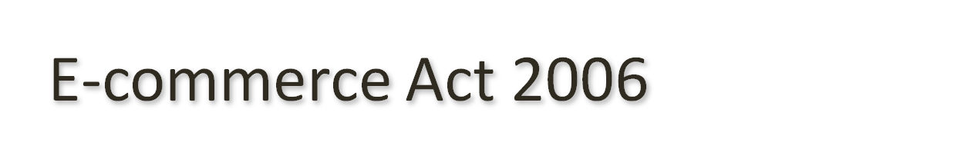
regulates online commercial transactions
requires all online businesses provide valid and truthful representation of themselves
requires all online marketplace operators to keep track carefully of all the buyers and sellers on their sites.
affirms the legal validity of commercial transactions conducted by electronic means.
UECS3313/MPU33213-SE-Oct2015

